Slide 1
Comparing annual members and casual riders in Cyclistic
Created by: Rishabh Karade
Last Updated: 21st Sept 2024

Slide 2
Case:
Cyclistic’s finance analysts have concluded that annual members are much more profitable than casual riders. Although the pricing flexibility helps Cyclistic attract more customers, Moreno believes that maximizing the number of annual members will be key to future growth. Rather than creating a marketing campaign that targets all-new customers, Moreno believes there is a solid opportunity to convert casual riders into members. She notes that casual riders are already aware of the Cyclistic program and have chosen Cyclistic for their mobility needs
Moreno wants to know:
1. How do annual members and casual riders use Cyclistic bikes differently?
2. How can we convert casual riders into annual members?

Slide 3
Company Profile:
In 2016, Cyclistic launched a successful bike-share offering. Since then, the program has grown to a fleet of 5,824 bicycles that are geotracked and locked into a network of 692 stations across Chicago. The bikes can be unlocked from one station and returned to any other station in the system anytime.
Until now, Cyclistic’s marketing strategy relied on building general awareness and appealing to broad consumer segments. One approach that helped make these things possible was the flexibility of its pricing plans: single-ride passes, full-day passes, and annual memberships. Customers who purchase single-ride or full-day passes are referred to as casual riders. Customers who purchase annual memberships are Cyclistic members.

Slide 4
Problem:
Solution:
How to convert casual riders into members?
Implementing flexible plans tailored to the needs of casual riders.

Slide 5
Analytical Goals
HOW: Convert casual members into annual members
HOW: Different is the bike usage of casual riders and members

Slide 6
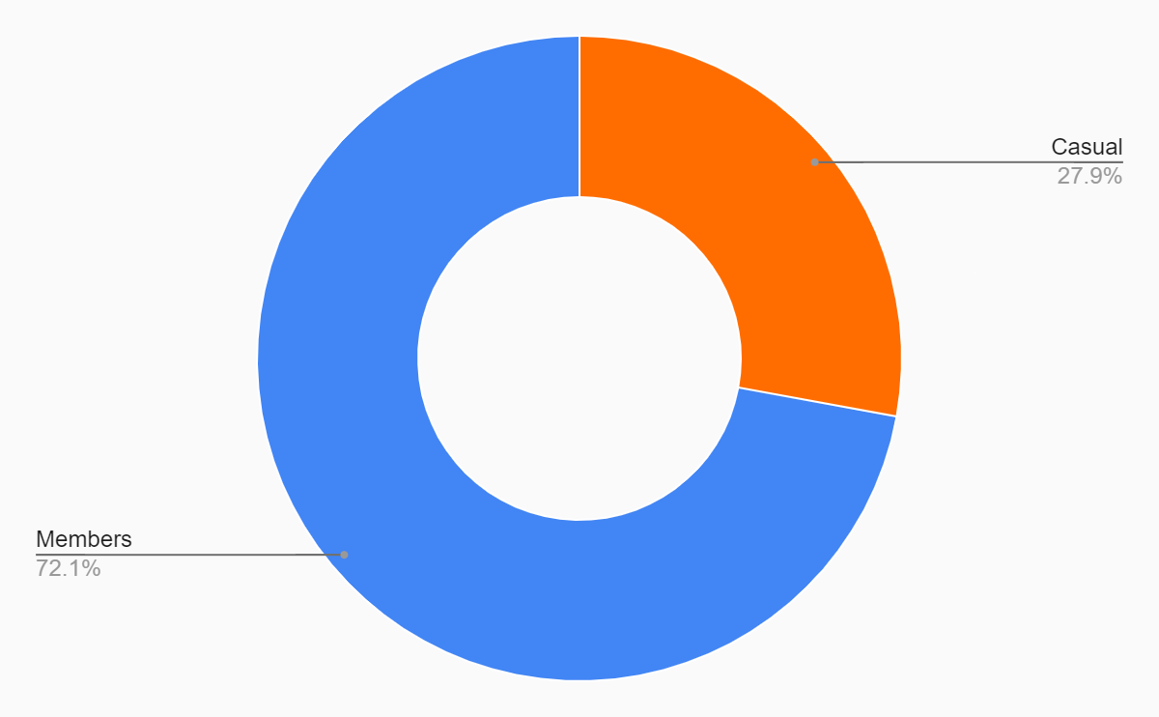
Majority Riders:
Majority of riders are members.
72.1% riders are annual members
While 27.9% of riders are casual riders who do not own an annual subscription.

Slide 7
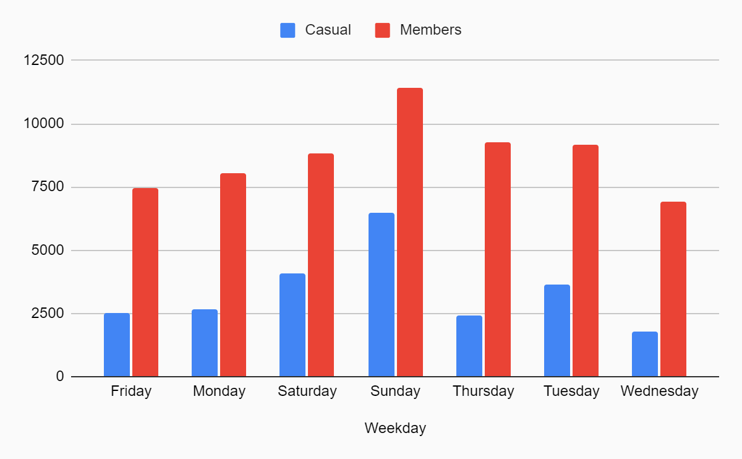
Majority Riders:
Weekends see a surge in both casual and member riders.
Sundays have the highest number of riders.

Slide 8
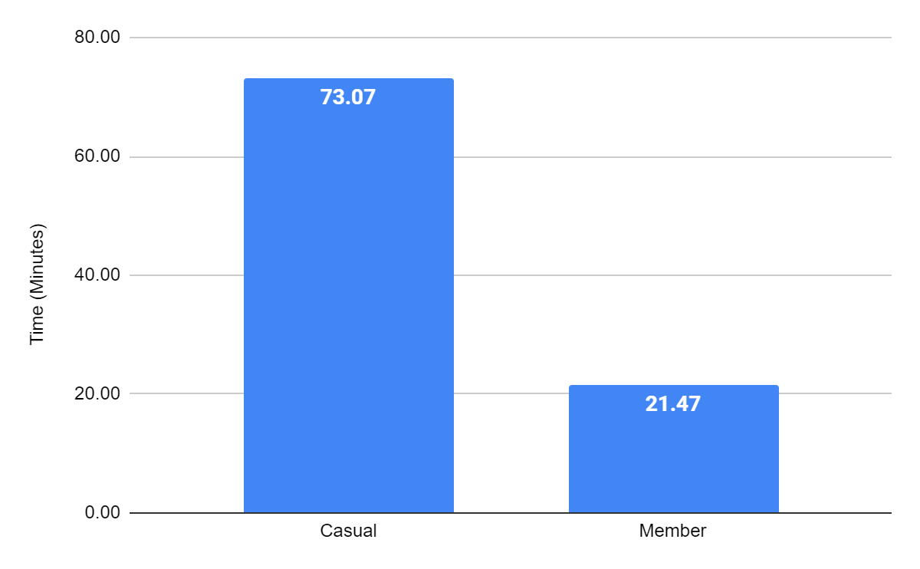
Ride Duration:
Casual riders have an average ride duration of 73.07 minutes, while members have an average of 21.47 minutes.
This indicates that casual riders typically use bikes for approximately 3.4 times longer than members.

Slide 9
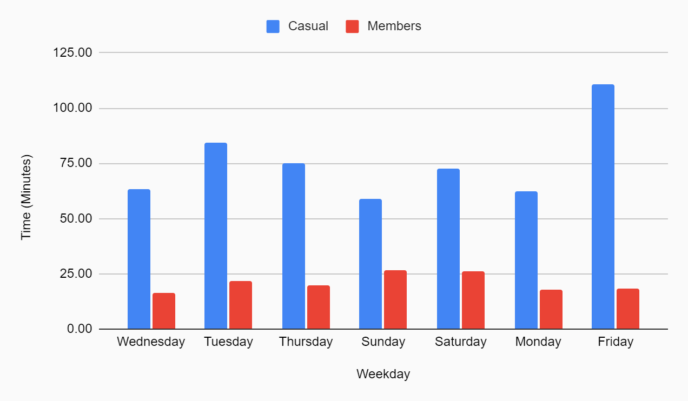
Ride Duration:
Casual riders use bikes longer than members throughout the week.
However, this difference peaks on Fridays, which note the highest average duration of casual rides.

Slide 10
Summary:
Although members use bikes more often than casual riders, casual riders tend to use it longer than the members.
Casual riders exhibit the longest average ride durations on Fridays compared to any other weekday.

Slide 11
Summary:
Weekends consistently see the highest number of rides for both members and casual riders, with Sunday being the peak day.
Members exhibit consistent bike usage throughout the workweek, suggesting regular commuting patterns.

Slide 12
Recommendations:
Introducing day passes and monthly subscription plans can encourage casual riders to use the services without committing to a long-term membership. This could lead to increased familiarity and a higher likelihood of purchasing an annual plan.
Provide exclusive member perks such as priority access to bikes which will encourage casual riders to buy a subscription plan.

Slide 13
Recommendations:
Offering weekday discount plans which will attract more casual riders to use the service during off-peak hours. Since weekends see the highest number of casual riders, targeting them during these times can be particularly effective.
Introducing referral programs which will encourage members to refer friends and family, providing incentives for both the referrer and the new member.

Slide 14
THANK YOU

